Slide 1
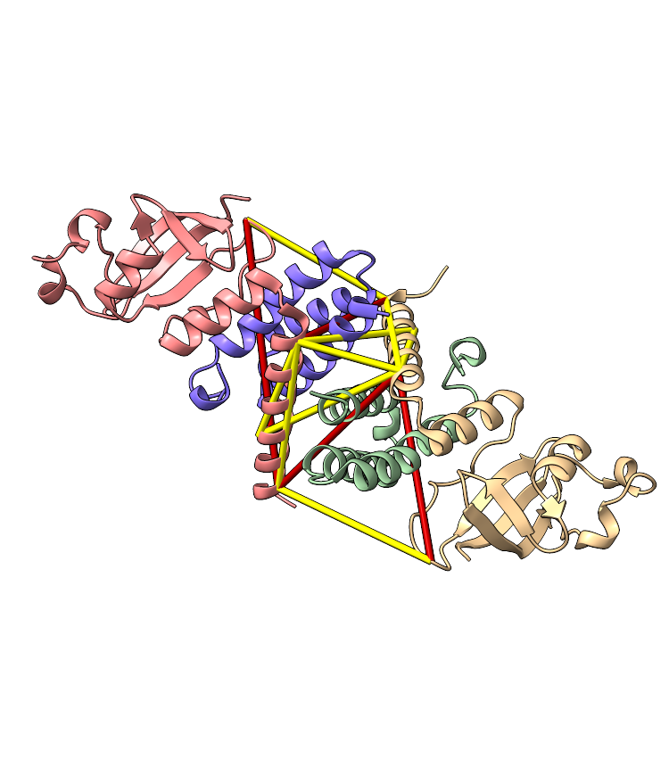
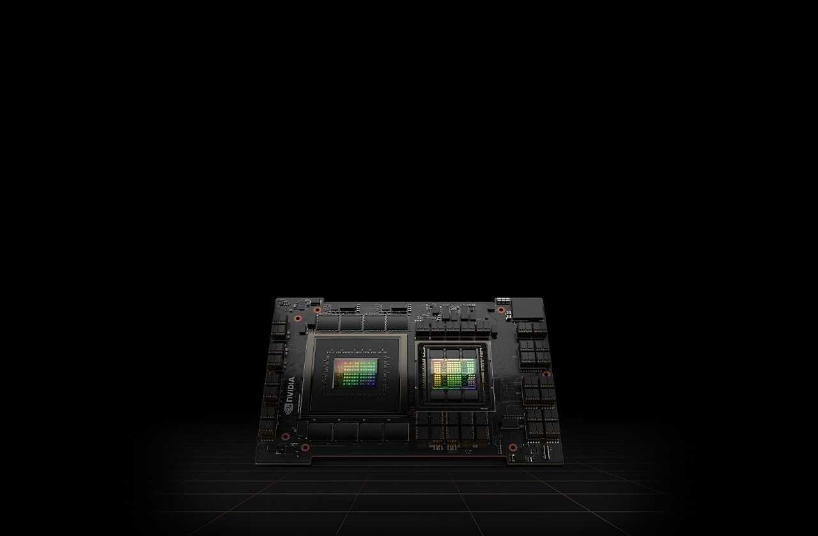
Solving big problems on small computers
alternative title: GPU-accelerated proteome-wide non-cleavable crosslink identification using sparse matrix multiplication
Micha Birklbauer, 19. February 2024

Slide 2
The Problem

Slide 3
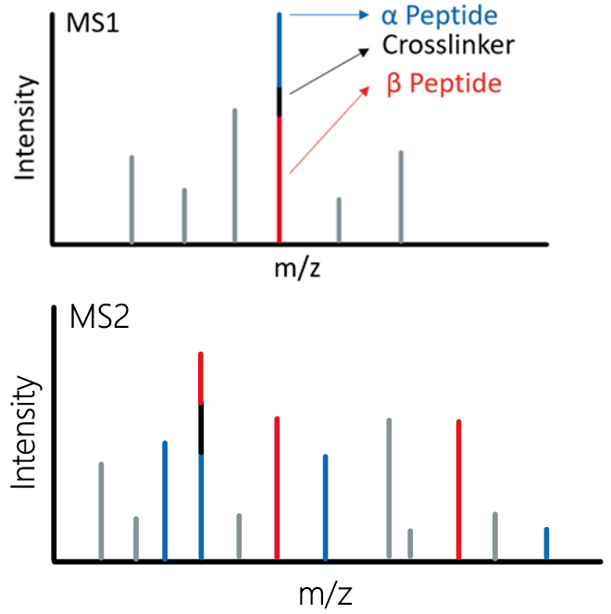
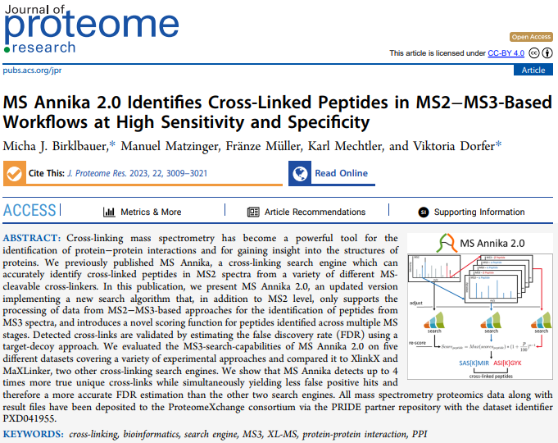
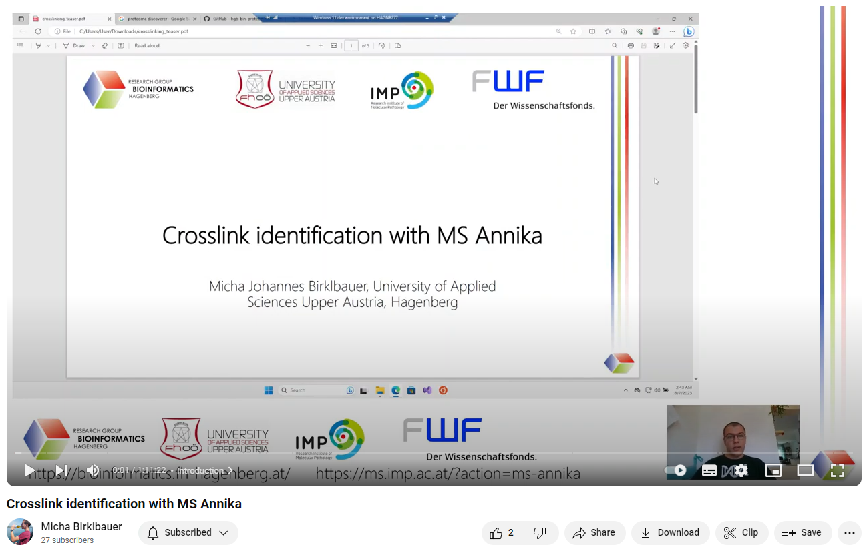
The Problem
In non-cleavable cross-linking experiments we cannot infer the masses of the two individual peptides
We know the mass of the complete cross-linked entity (precursor)
For identification we need to consider any combination of two peptides that make up the precursor mass
Want to know more about cross-linking?

Slide 4

The n² Problem
Considering every combination of peptides leads to very large search spaces
Consider a database of n peptides, the number of possible combinations c would be:
$c=\left(\begin{matrix}n \\ 2\end{matrix}\right)+n=\left(n+1\right)∗ \frac{n}{2}$
For big n this can be considered O(n²) complexity
For the human proteome (swissprot, 20 337 p), trypsin digest, maximum 3 missed cleavages, 5 – 30 peptide length:
n = 2 749 058
c = 3 778 661 318 211
Min memory occupancy of one combination = int64, int32, int32 = 16 bytes
Total = ?

Slide 5

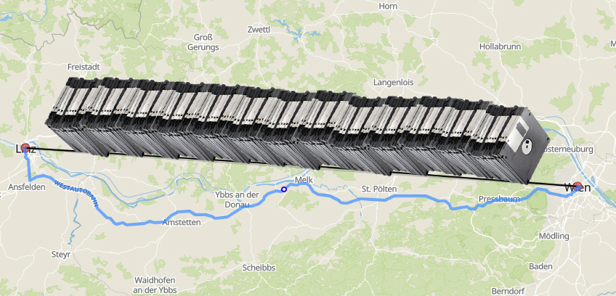
54.98676 TB
This would roughly fit on three enterprise-level hard disks
Or on enough 3.5“ floppy disks to cover the distance from Linz to Vienna

Slide 6

Tackling the n² Problem
Three different options:
Cry
Reducing the search space
Speeding up the search process so more combinations can be considered
source: giphy.com

Slide 7
The Idea

Slide 8
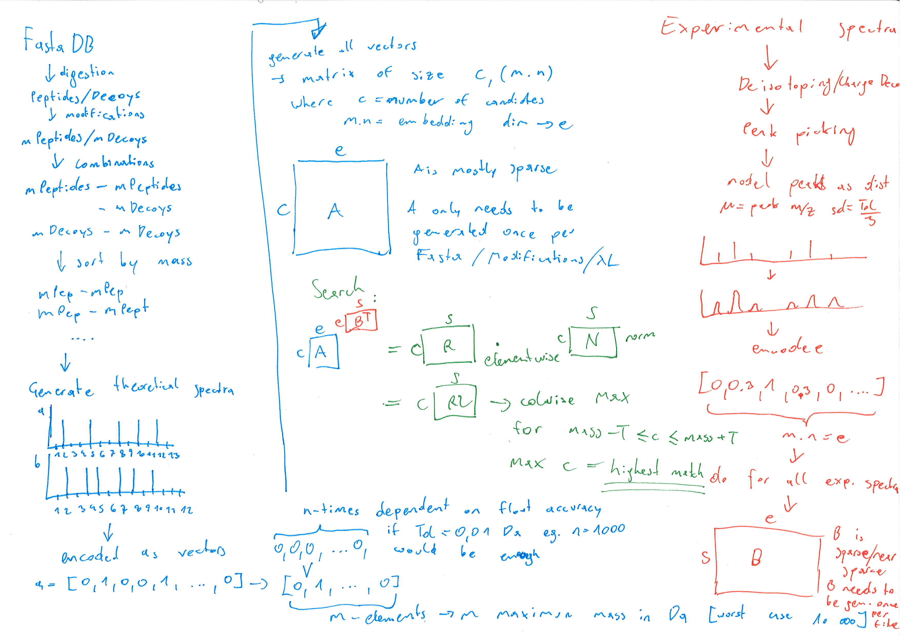

Slide 9
The Idea
Reduction of search space:
Identify one of two peptides first
→ Limits the number of combinations to consider
Identification of the peptide by a fast approximate search:
Purely based on addition and multiplication
Adhering to the SIMD paradigm

Slide 10
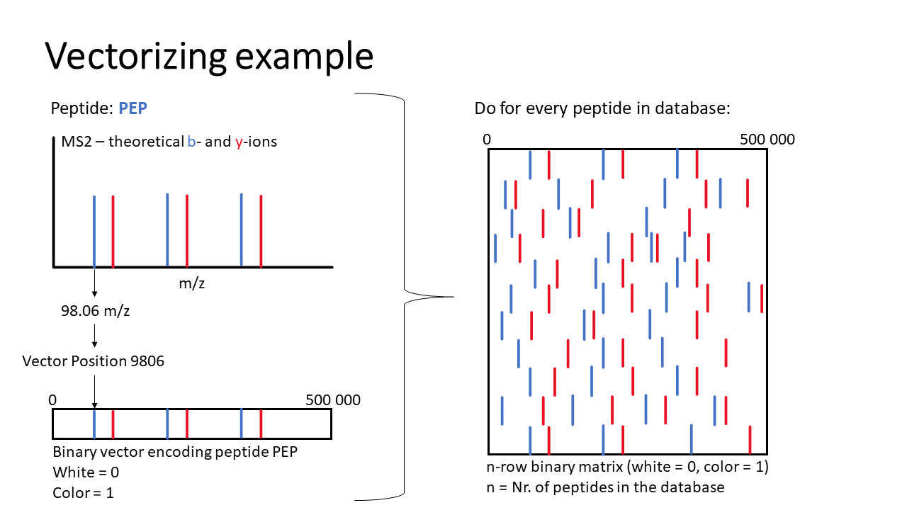

Slide 11
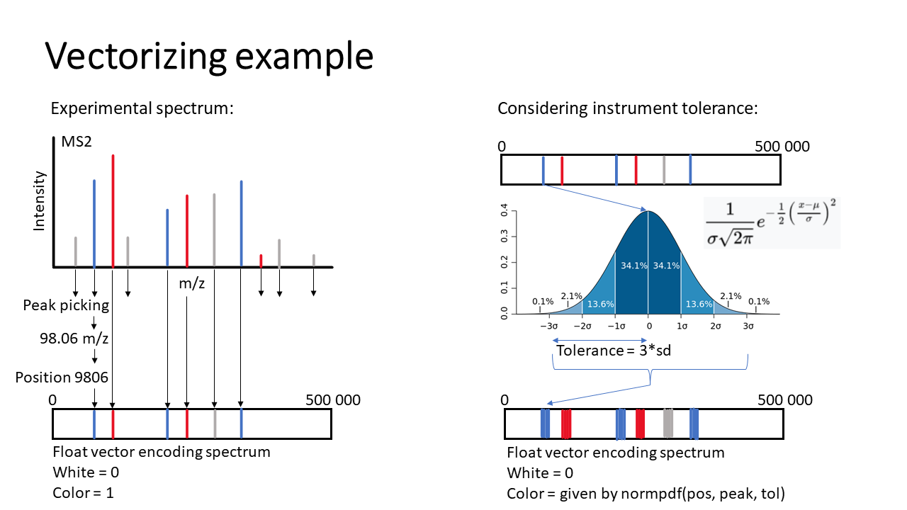

Slide 12
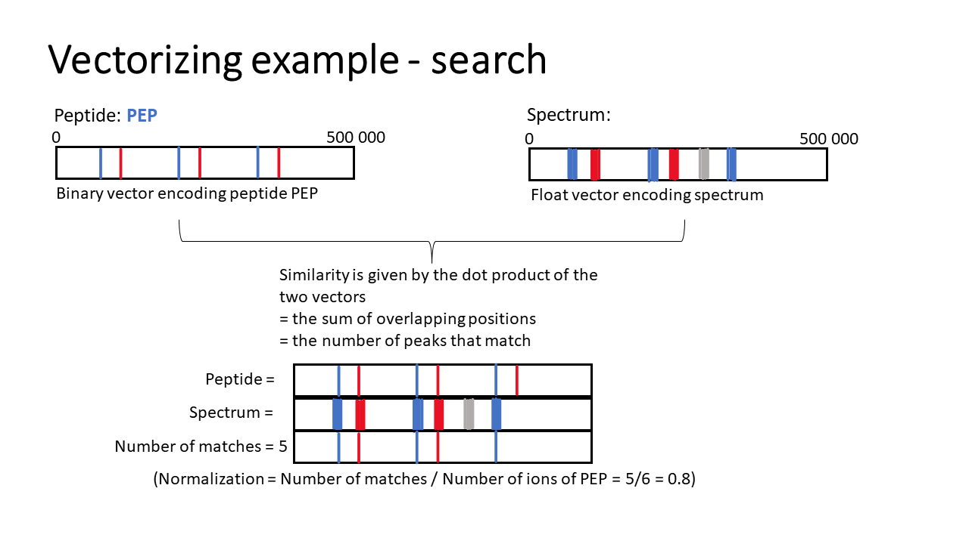

Slide 13
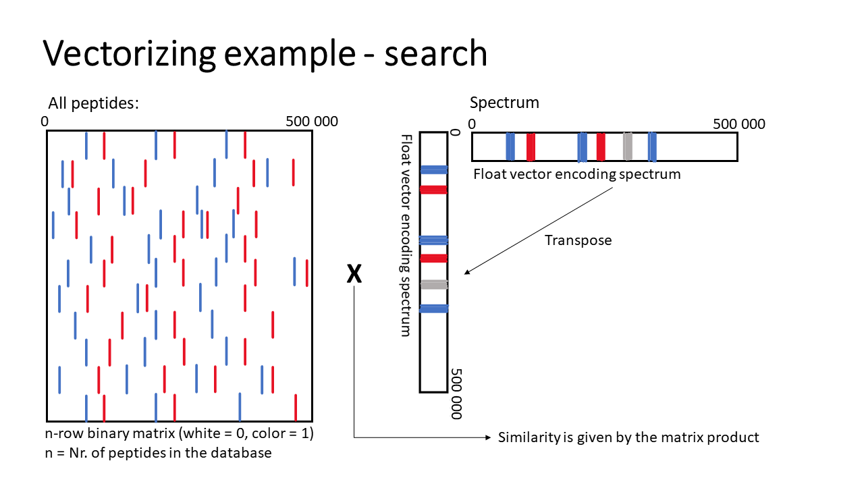

Slide 14
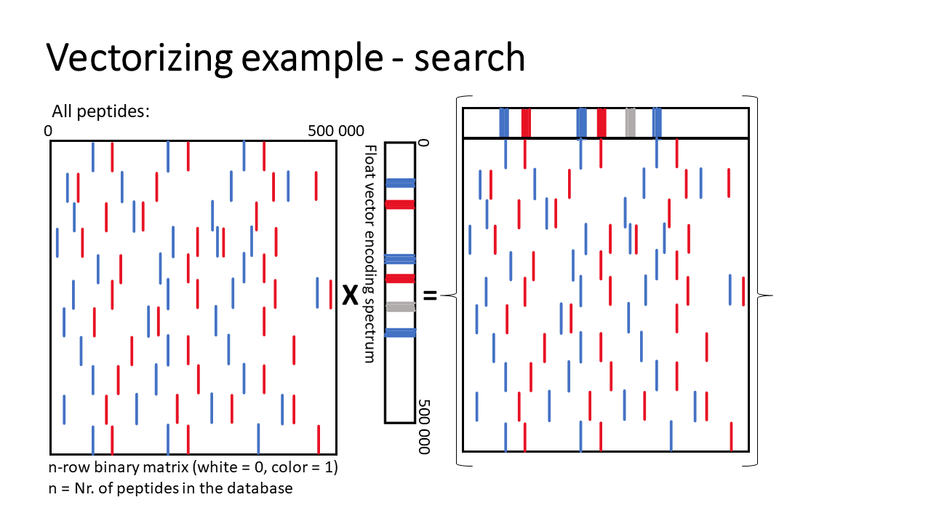

Slide 15
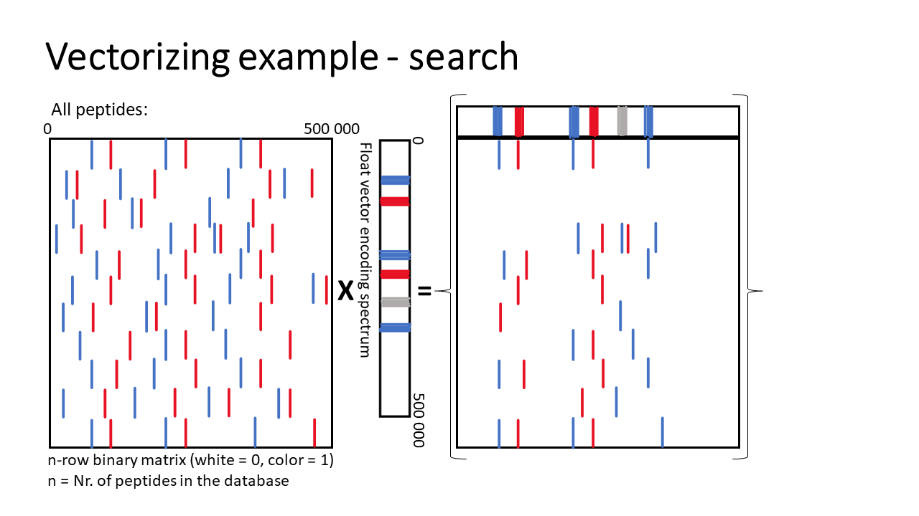

Slide 16
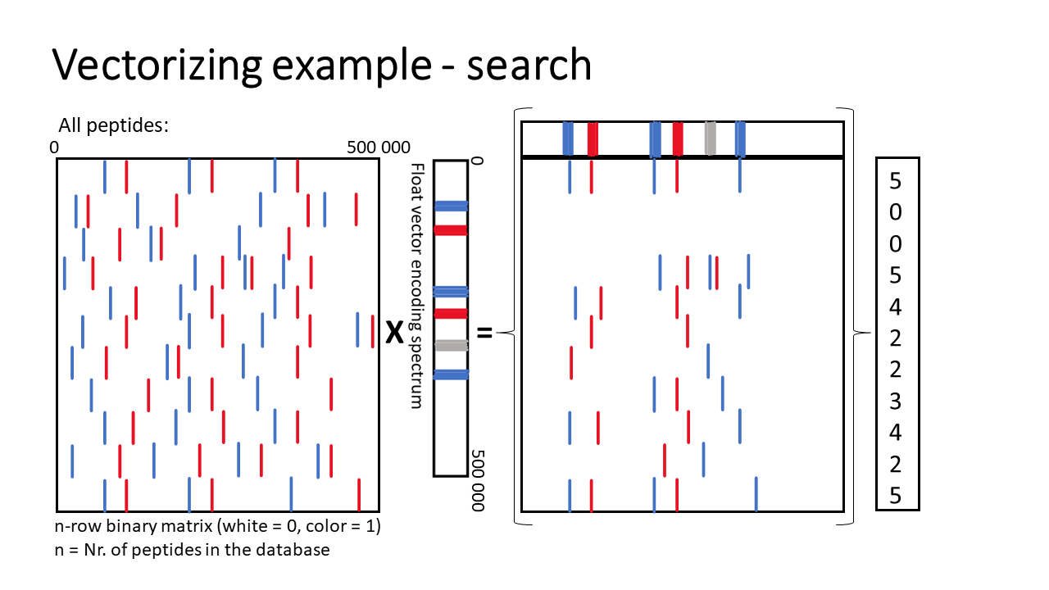

Slide 17
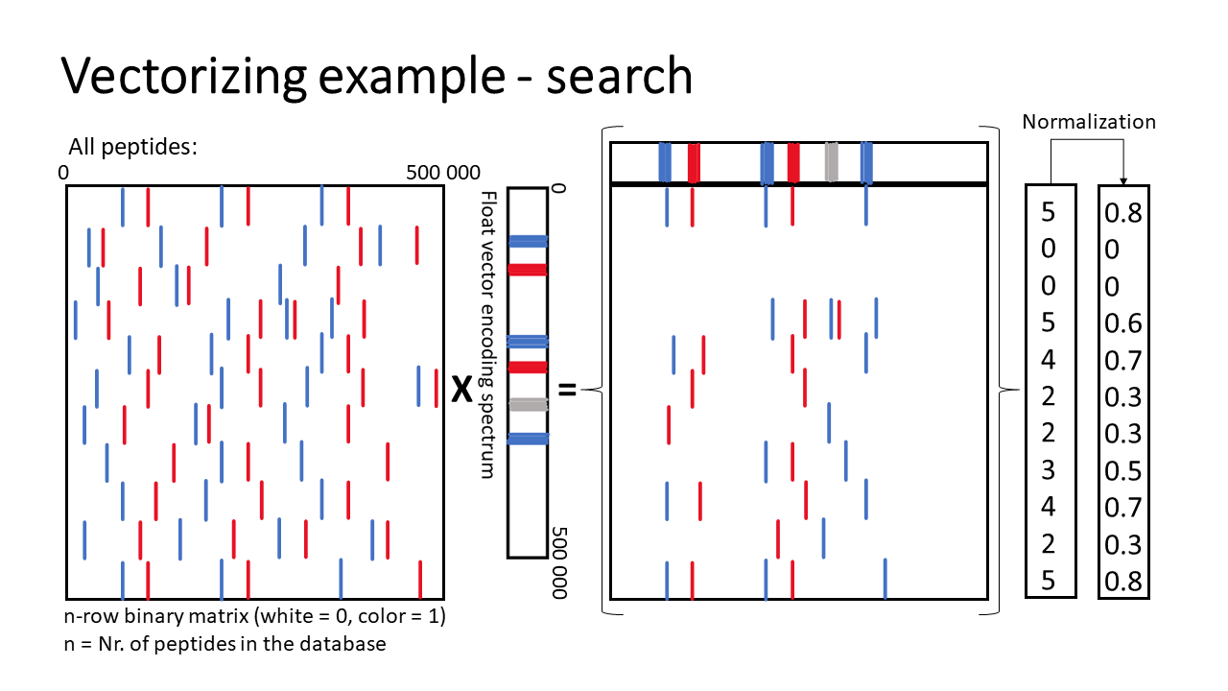

Slide 18
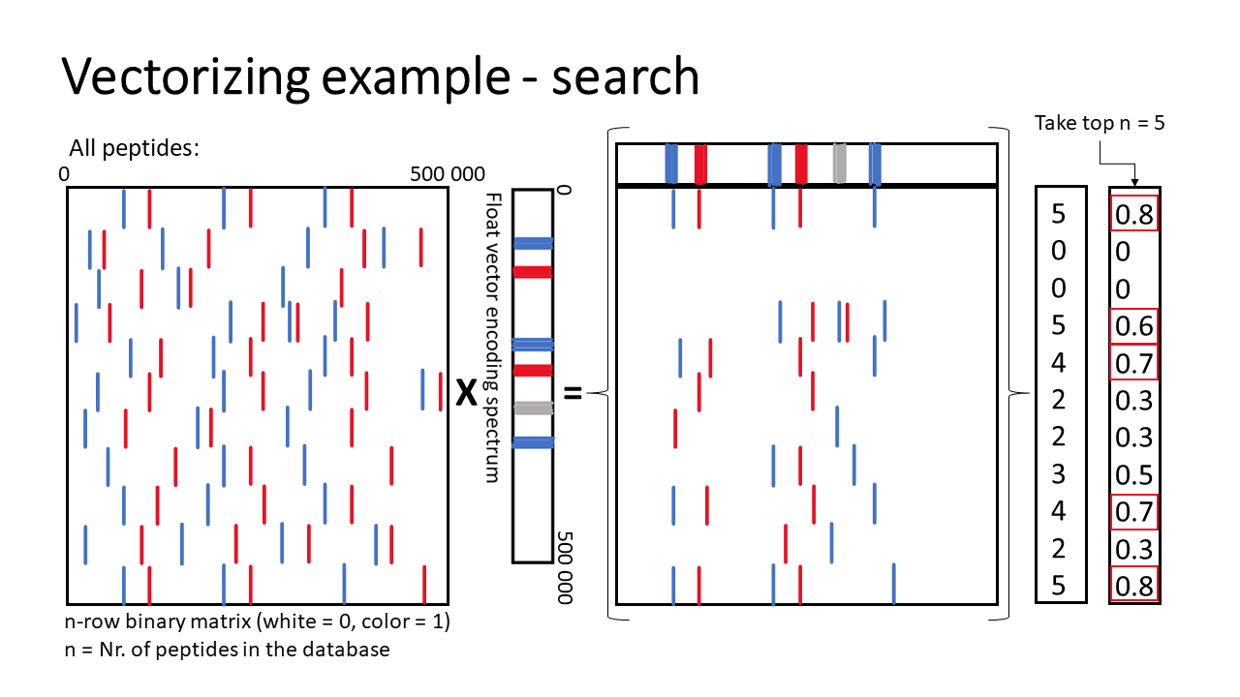

Slide 19
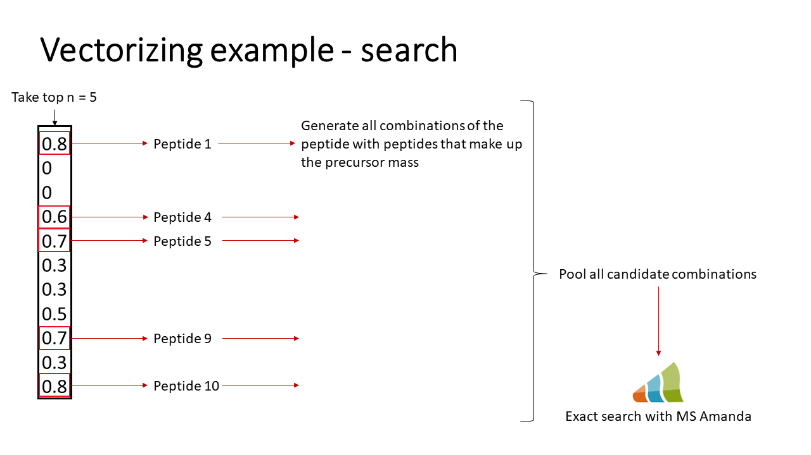

Slide 20
The quest of choosing the the right technology stack

Slide 21
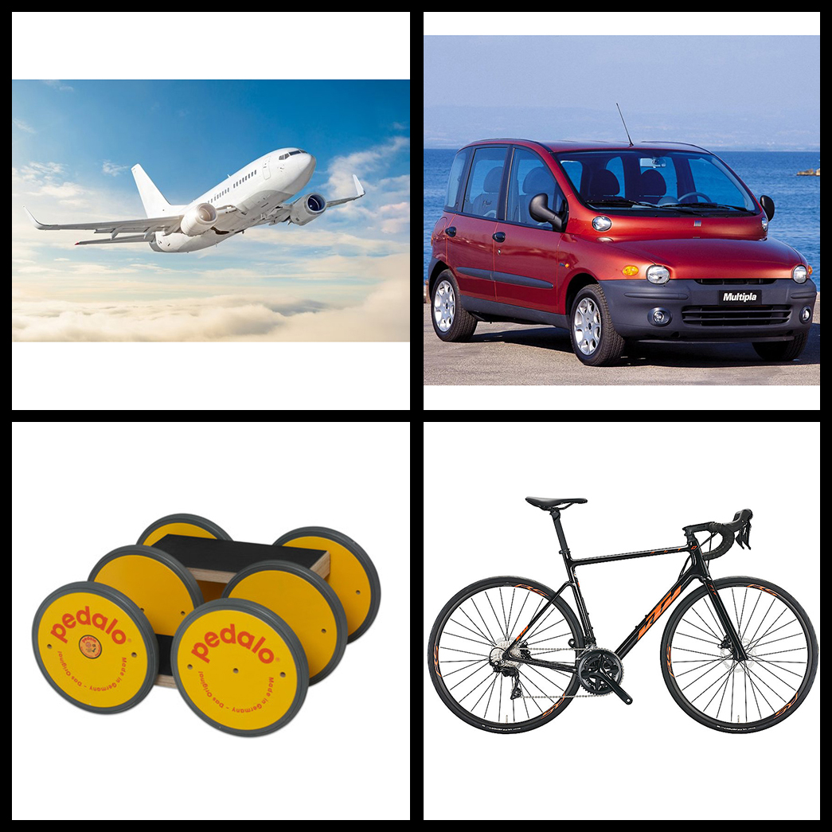
Q: What is the fastest?
A) Pedalo
B) Bike
C) Car
D) Plane

Slide 22
Q: What is the fastest?
A) Pedalo
B) Bike
C) Car
D) Plane

Slide 23

Q: What is the fastest if I am steering?
A) Pedalo
B) Bike
C) Car
D) Plane

Slide 24
Q: What is the fastest if I am steering?
A) Pedalo
B) Bike
C) Car
D) Plane

Slide 25

Q: What is the fastest?
A) Python
B) C#
C) C++
D) Julia

Slide 26
Q: What is the fastest?
A) Python
B) C#
C) C++
D) Julia

Slide 27

Q: What is the fastest for MS Annika?
A) Python
B) C#
C) C++
D) Julia

Slide 28
Q: What is the fastest for MS Annika?
A) Python
B) C#
C) C++
D) Julia

Slide 29
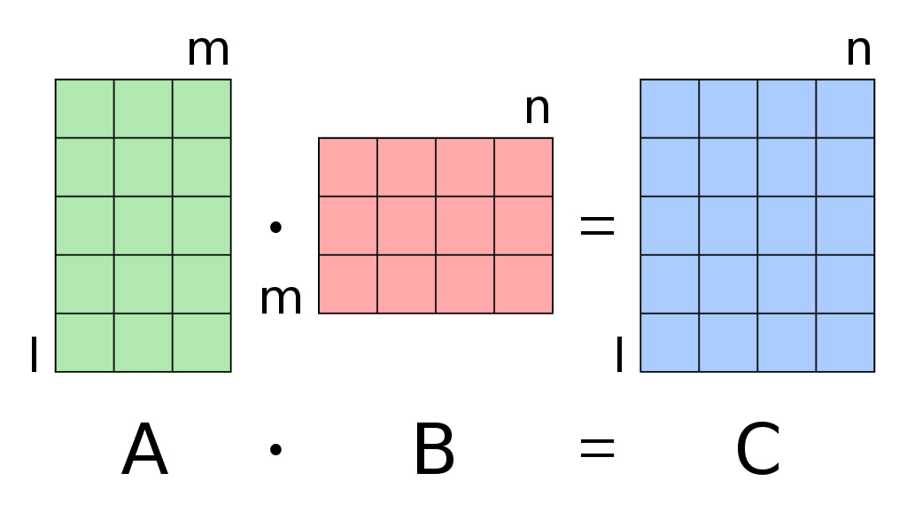
Prototypes
Native C#:
ALGLIB
Math.NET
System.Numerics.Vector
Julia
SparseArray
C++
ViennaCL
Eigen
source: en.wikipedia.org/matrix_multiplication

Slide 30
Results
Native C#:
ALGLIB → FAILED
Math.NET → Too slow
System.Numerics.Vector → Only supports 4D vectors
Julia
SparseArray → IO bottleneck
C++
ViennaCL → FAILED
Eigen → Very fast in every regard
Implementations: https://github.com/hgb-bin-proteomics/NC_Annika_prototypes

Slide 31
The tale of how I accidentally re-invented compressed sparse row format

Slide 32
Challenges
Availability of compute types
Out-of-core operations
Sparsity patterns
Row-major vs column-major
Marshalling data

Slide 33

Challenges
}
Availability of compute types
Out-of-core operations
Sparsity patterns
→ Be conservative
Row-major vs column-major
→ Result needs to be column-major because we need fast column access
Marshalling data
source: birdfact.com

Slide 34
Marshalling Big Matrices
Marshalling: Transmitting data and communication between C# and C++
Need to use datatypes that are common to both
→ int32 arrays
Memory managment
C#: Managed
C++: Unmanaged
We can‘t marshall flat arrays because of unknown size
Unmanaged
CLR
Marshalling
Managed

Slide 35
Marshalling Big Matrices
We don‘t actually marshal arrays but pointers to arrays
But wait, there are no pointers in C#?
Well, yes technically there are:
We need to tell the garbage collector to pin an object to a specific memory address
We can than marshal that address to the C++ dll
CandidateVectorSearch.dll
Unmanaged
CLR
Marshalling
Managed
CandidateSearch.dll

Slide 36
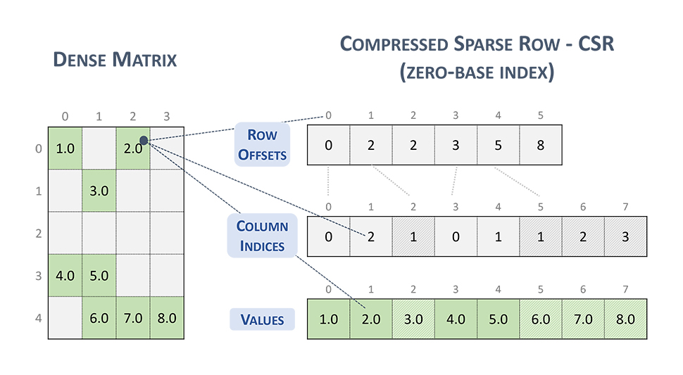
Marshalling Big Matrices
Can you spot the mistake in the official nvidia docs?
Marshalling the sparse matrices as dense arrays would be impossible, they would simply be too big
Thought: Only marshal column indices and an array that defines at which point a new row starts
→ That‘s basically CSR format
source: docs.nvidia.com/cuda/cusparse/

Slide 37
Benchmarks
Intel Core i7-1185G7 [4 cores @ 1.8 – 3.0 GHz]
16 GB DDR4 RAM [3200 MT/s, unknown CAS]
Nvidia T500 [2 GB VRAM]
1001 simulated spectra

Slide 38
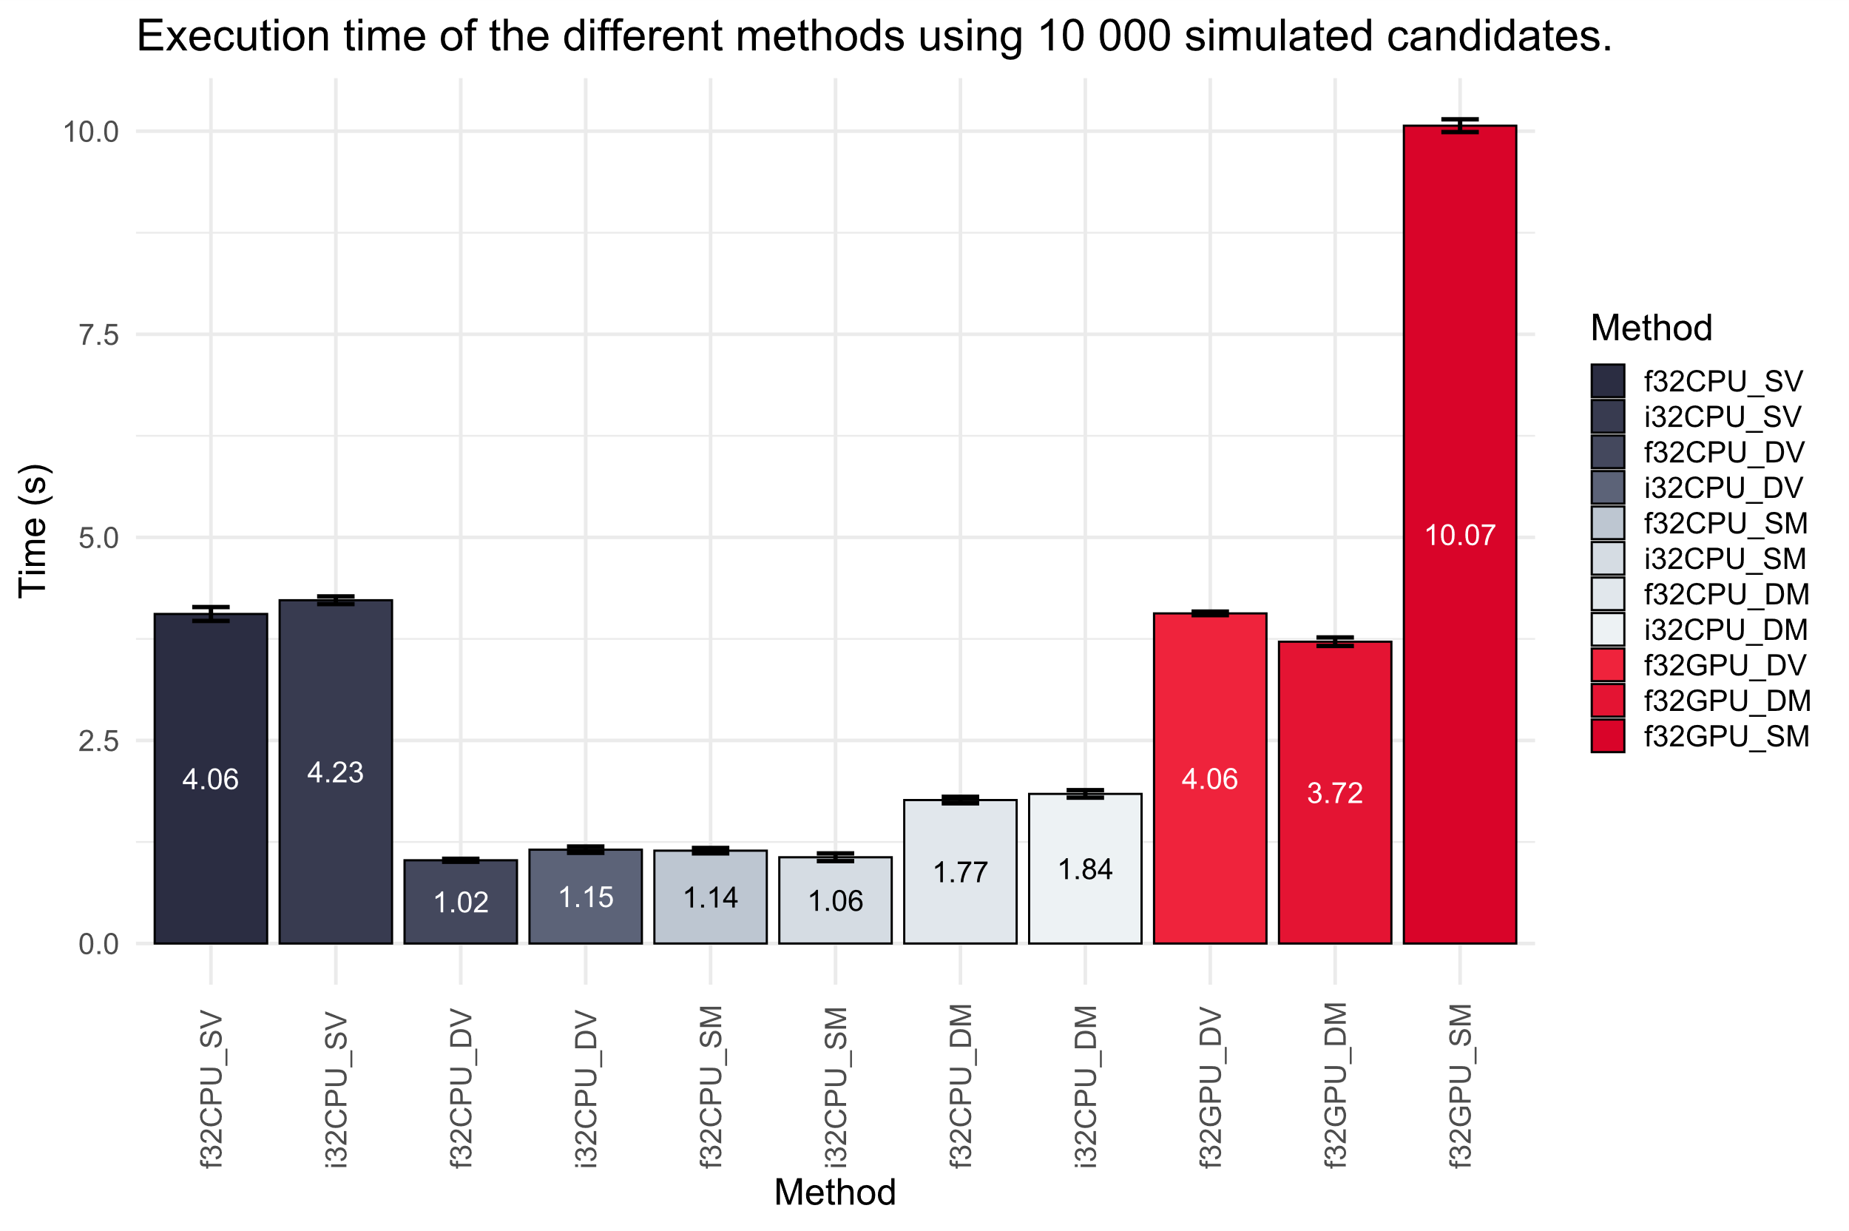

Slide 39
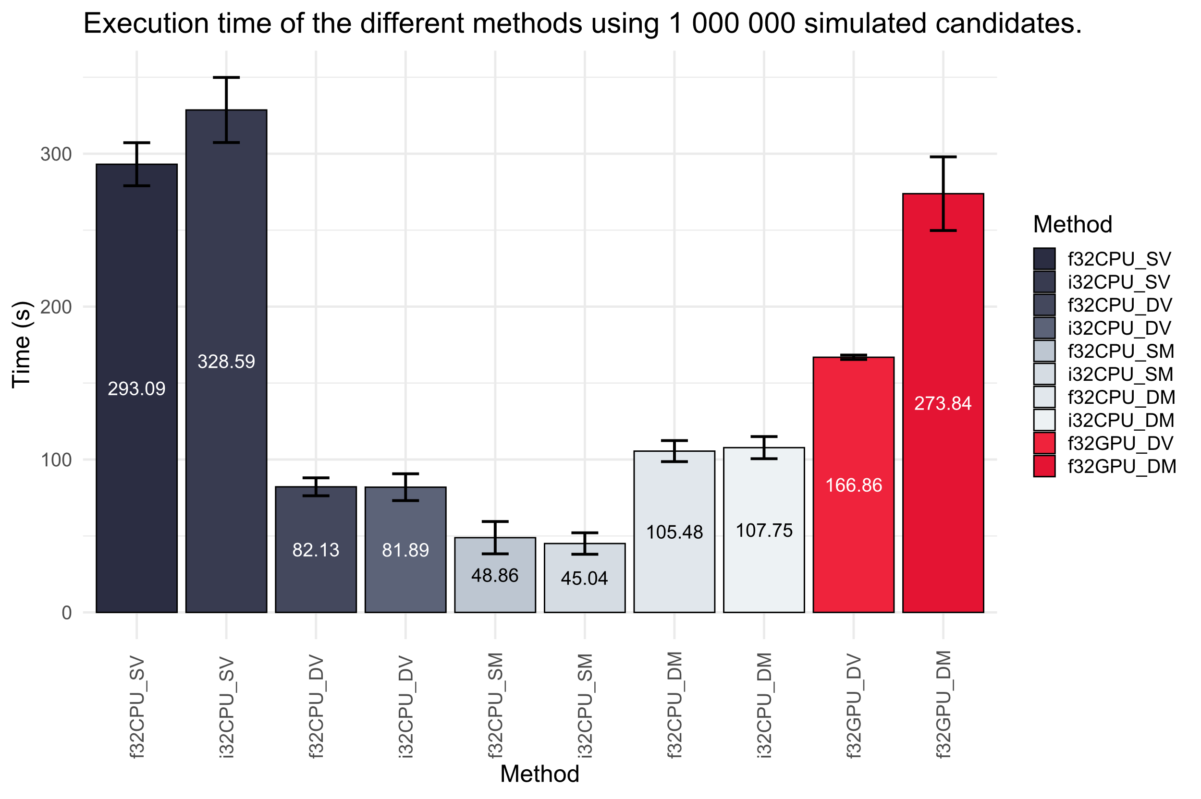

Slide 40
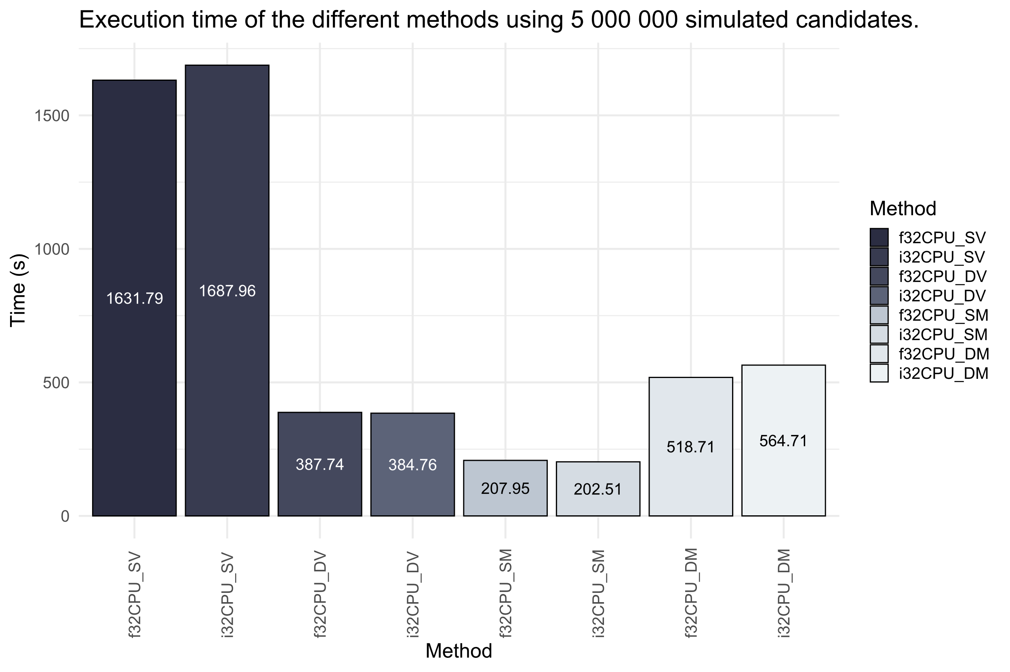

Slide 41

source: Morbius © Marvel Entertainment, LLC

Slide 42
The End Product
Quite literally…

Slide 43
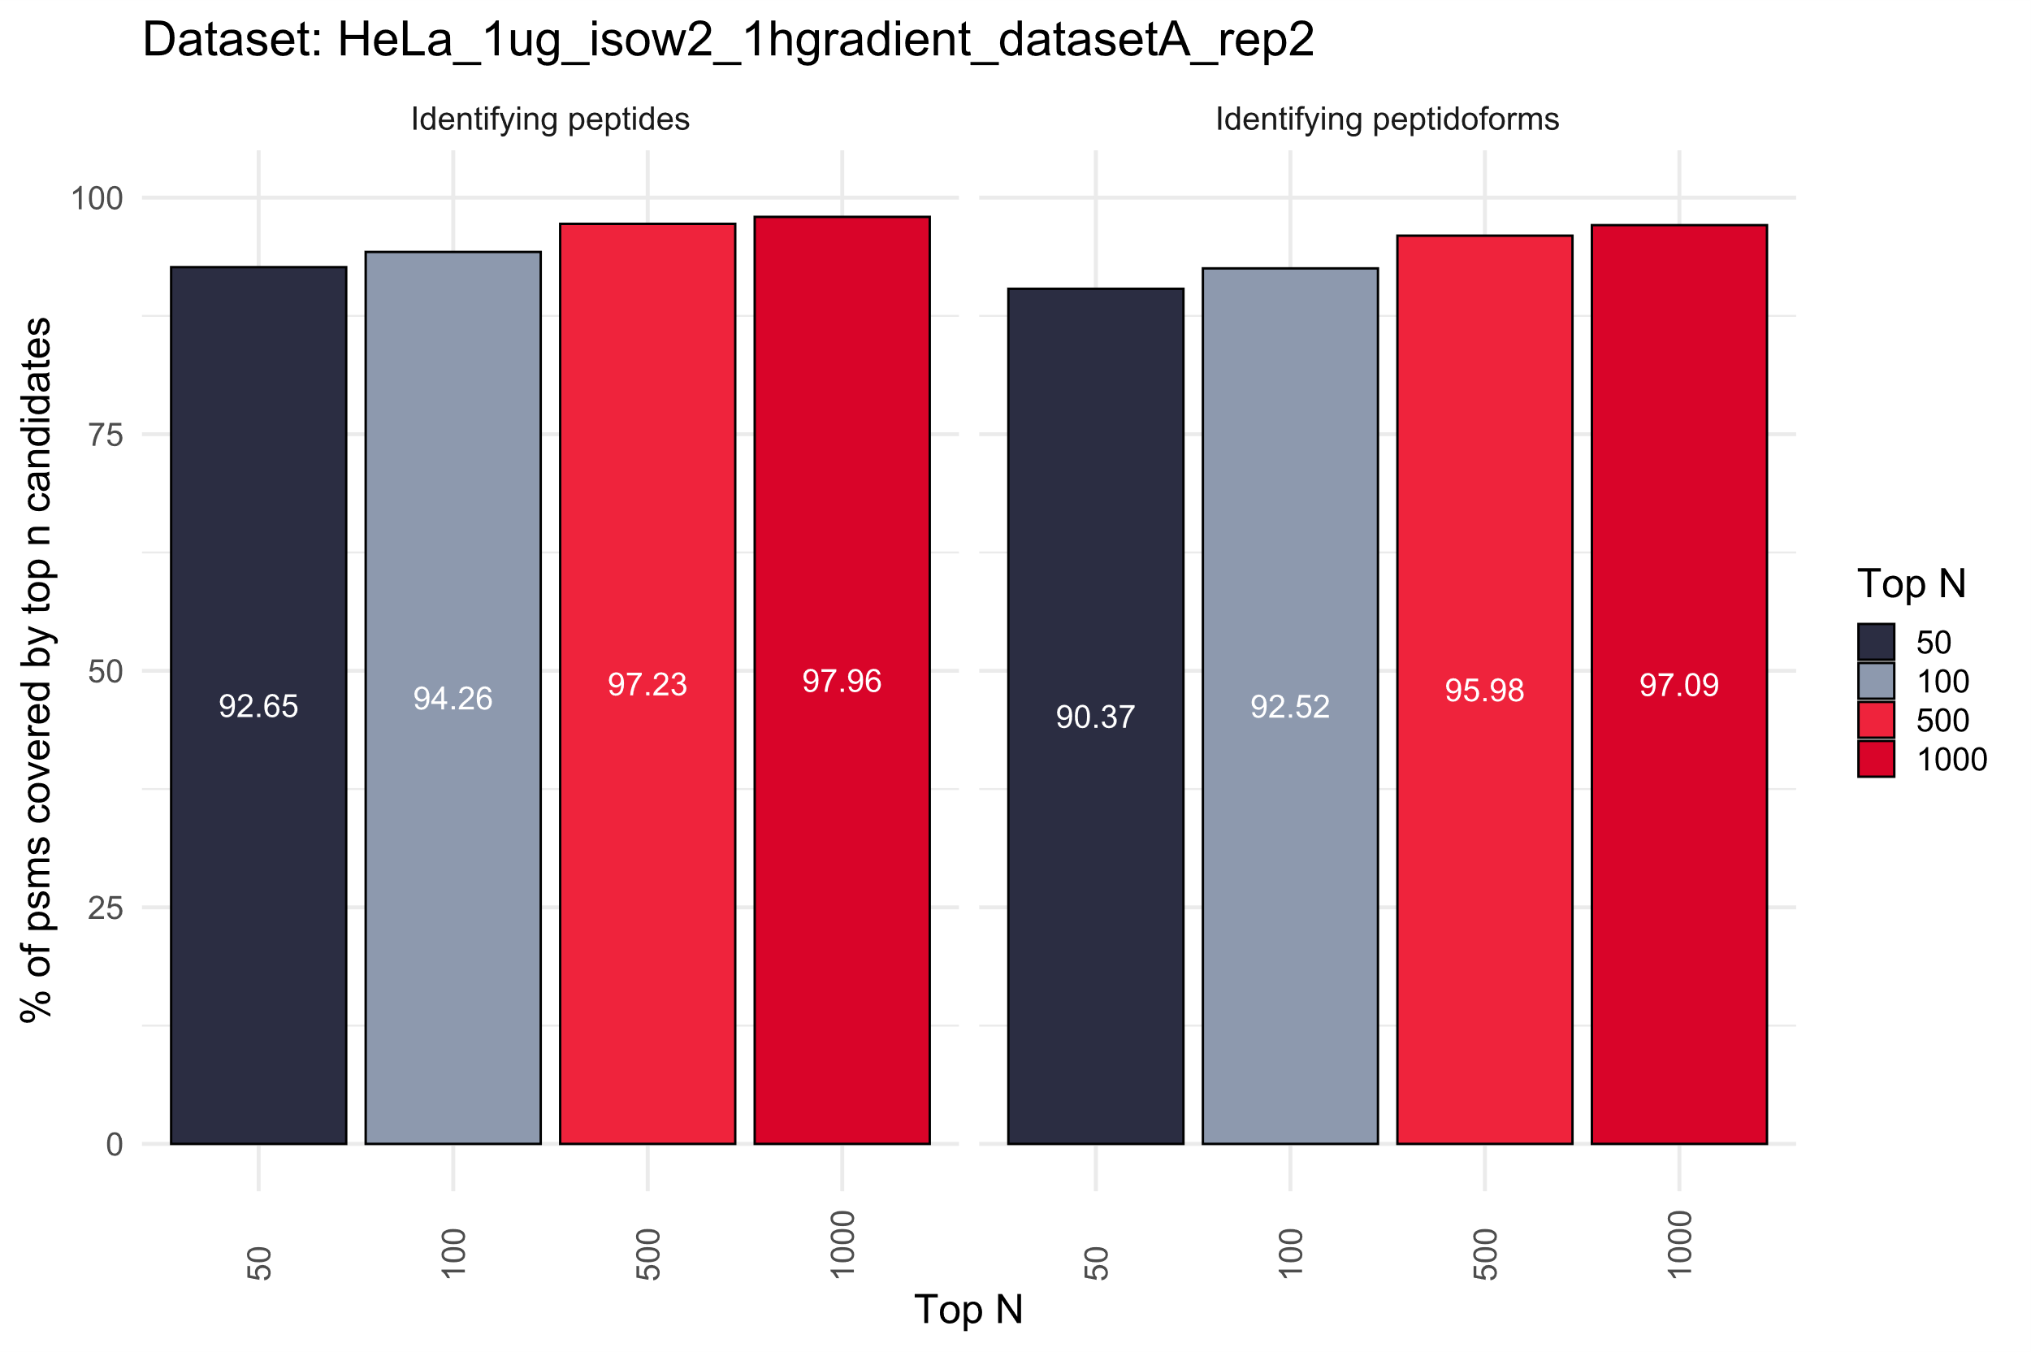
Database: Human SwissPort

Slide 44
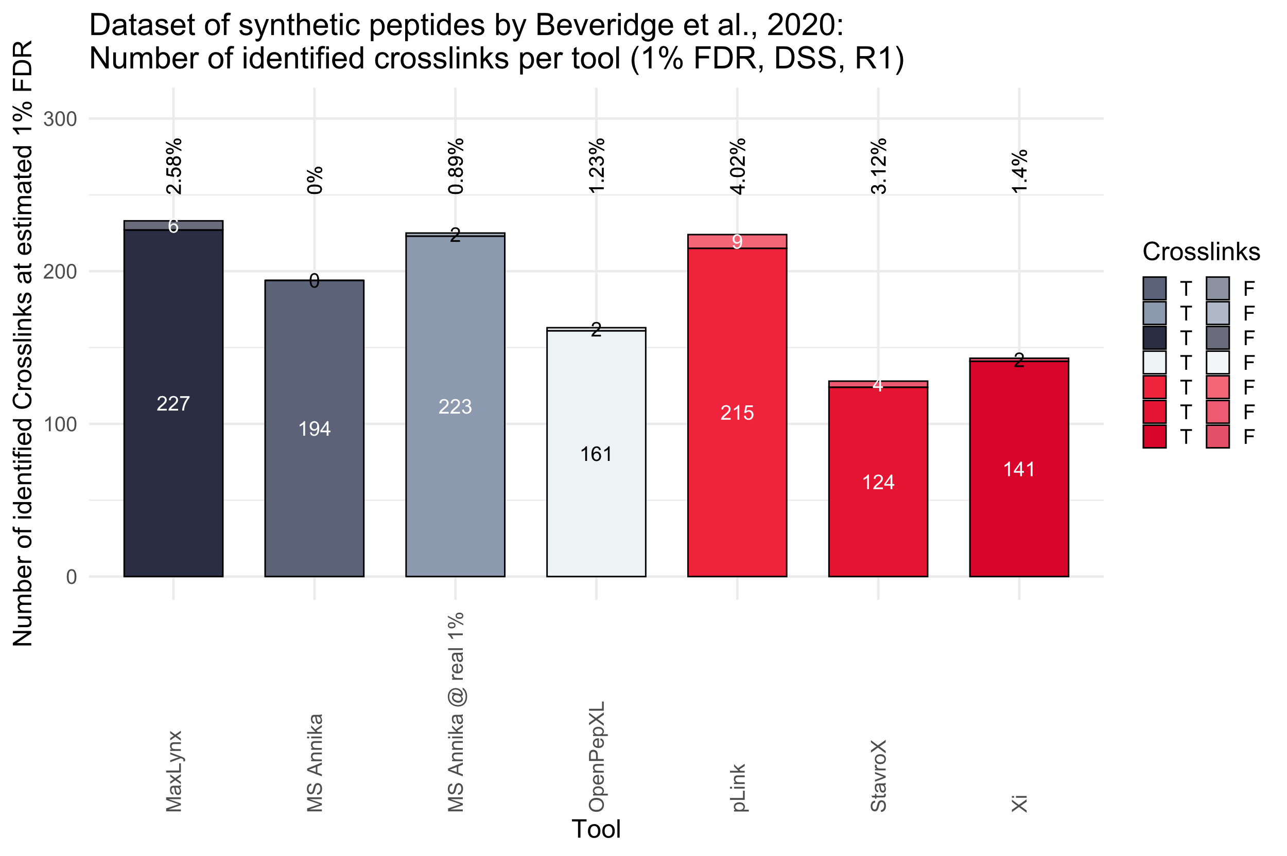
Database: Cas9 + 10

Slide 45
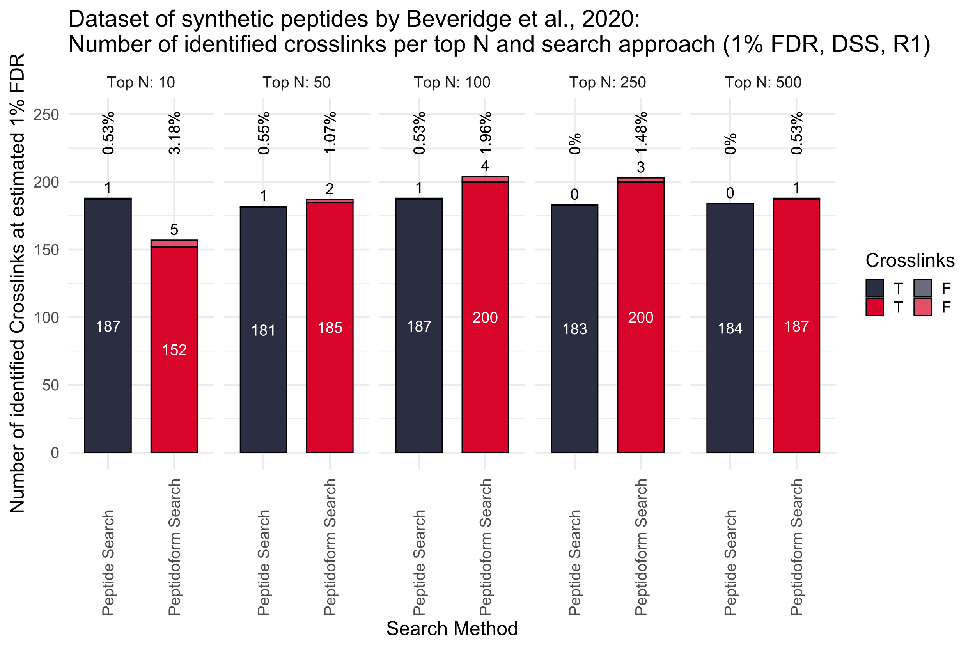
Database: Cas9 + 10

Slide 46
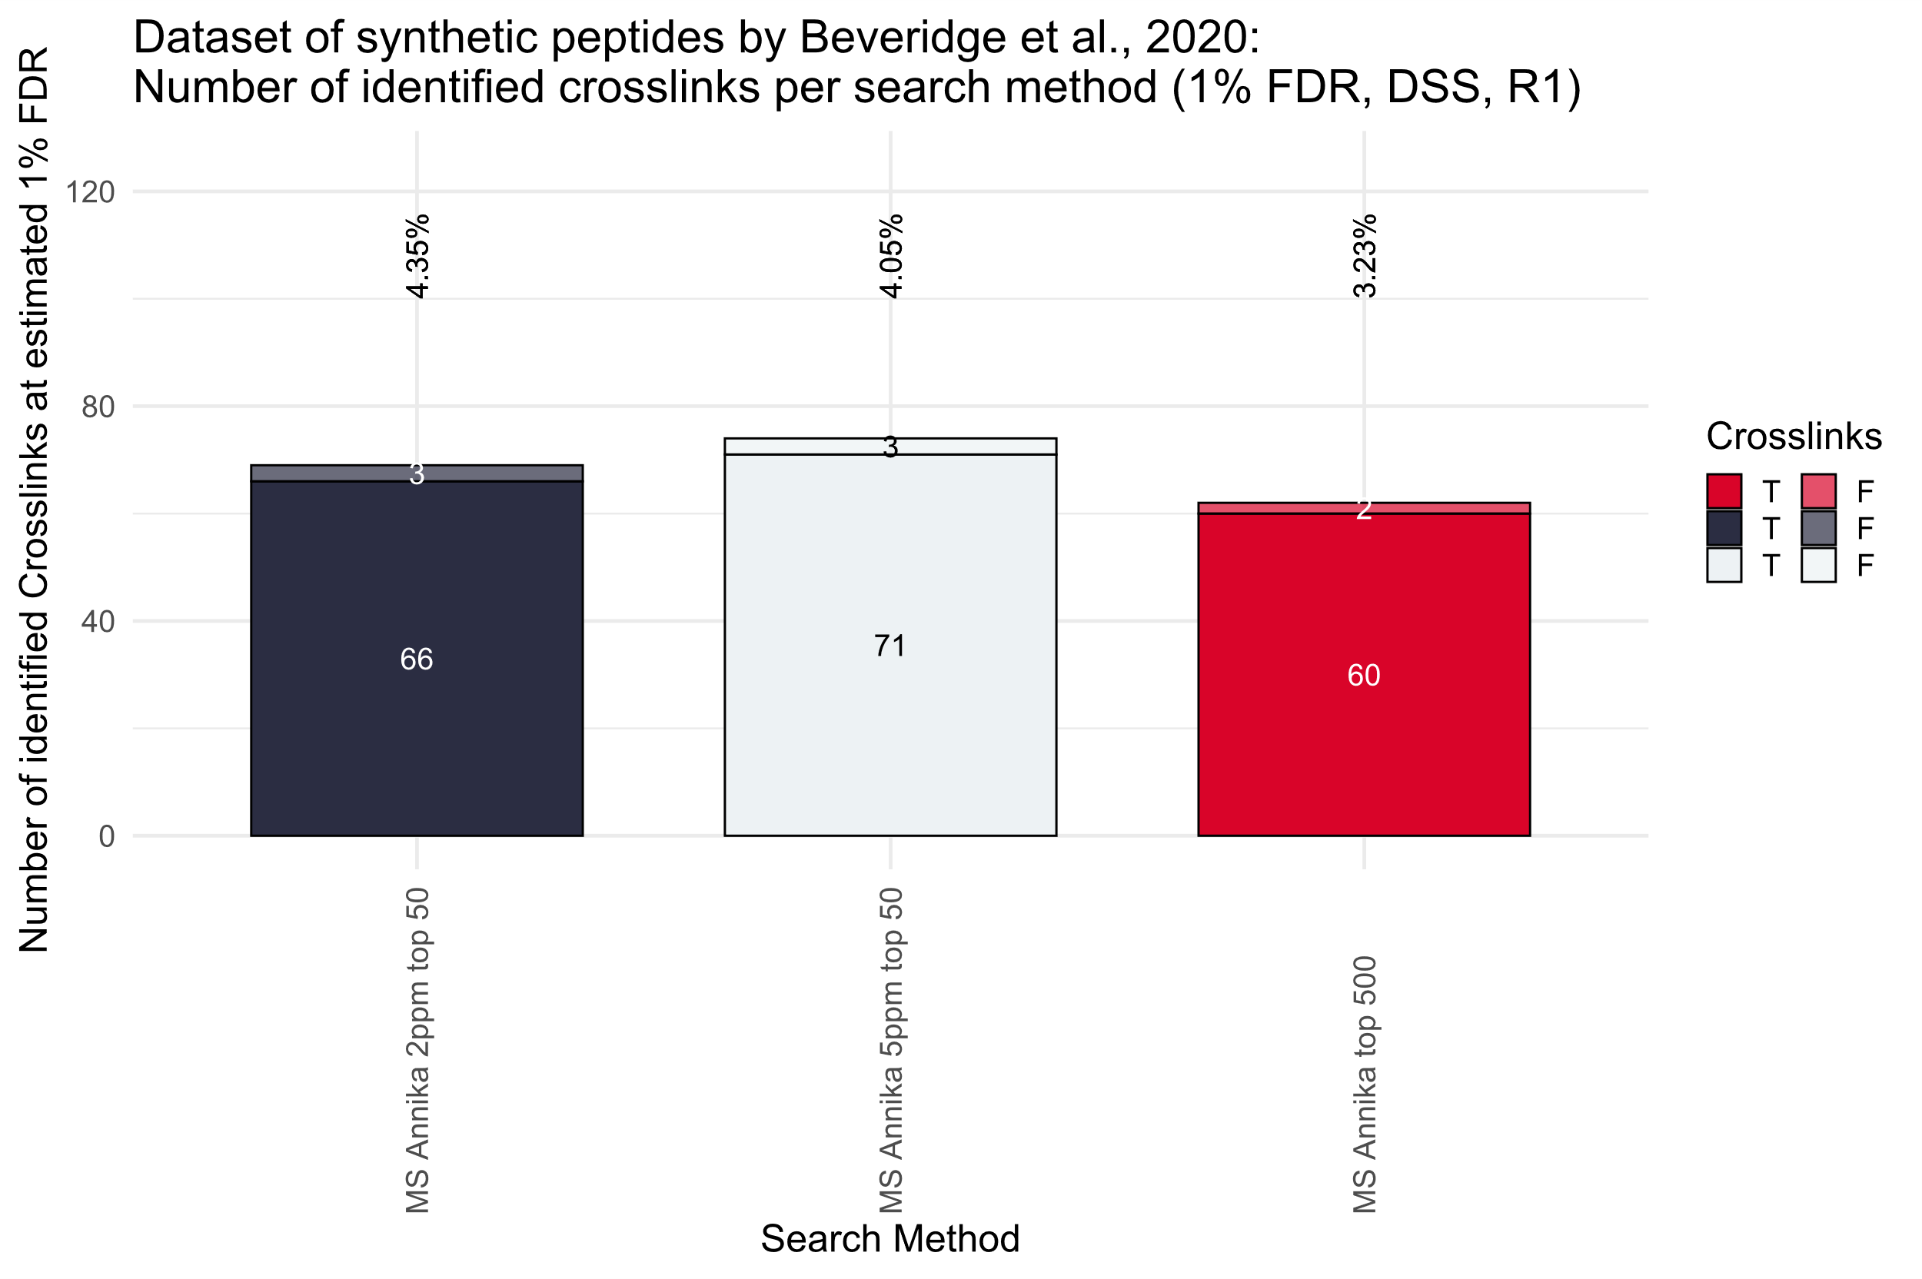
Database: Cas9 + Human SwissPort

Slide 47
Conclusions

Slide 48
Future Work
Done by me
Not done by me
Re-scoring of peptides based on the other peptides fragments
Extensive evaluation and testing
Out-of-core operations
Mixed compute types
Going from matrix to tensor operations
Going open source for GPU/TPU/NPU computing e.g. OpenCL

Slide 49
Takeaways
Don‘t be scared to try something new
Failing is part of the programmers / research experience
Reach out to other people doing similar stuff, (most) people actually don‘t bite – you might find some nice communities
Order of operations actually matters for optimization
BUT don‘t get lost in optimization (note to self)

Slide 50







Acknowledgements
The Eigen community
Chucky Schluz, Frank MD from Eigen
Sarah from from Eigen, FAER
Viktoria Dorfer
IMP, FWF & FH OÖ
Nvidia for Cuda
Microsoft for GitHub

Slide 51

The End
https://github.com/hgb-bin-proteomics/NC_Annika_prototypes
https://github.com/hgb-bin-proteomics/CandidateVectorSearch
https://github.com/hgb-bin-proteomics/CandidateSearch
https://github.com/sarah-ek/faer-rs
https://eigen.tuxfamily.org/
source: giphy.com

